Slide 1

<input type="search"/>
<ul>
<li>
Building Autosuggest Components
</li>
</ul>
Darren Jennings
June 2019
Notes:
Thanks for coming, I’m darren jennings. Chris asked me to speak as, I am sad to say, this will be my last meetup as a resident of California. I will be leaving at the end of this month to move back to my hometown of Louisville KY. Hope to make it back for work trips and hopefully it will coincide with these meetups! Before I go, I’d like to share what I’ve learned building best in class autosuggest components.

Slide 2
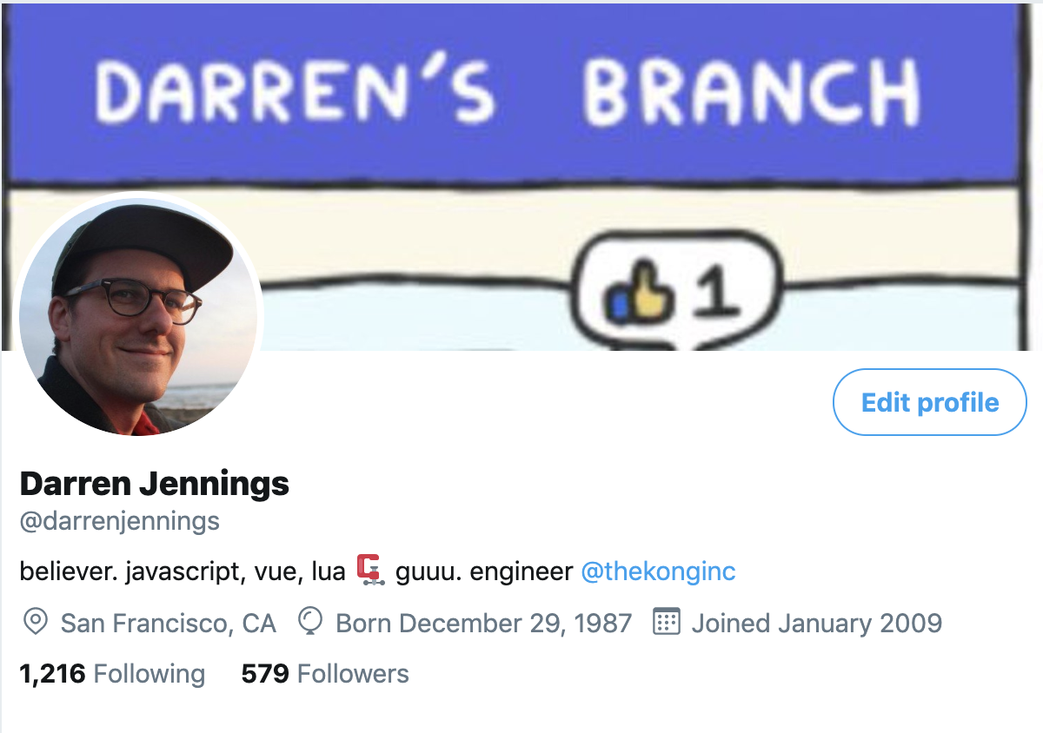
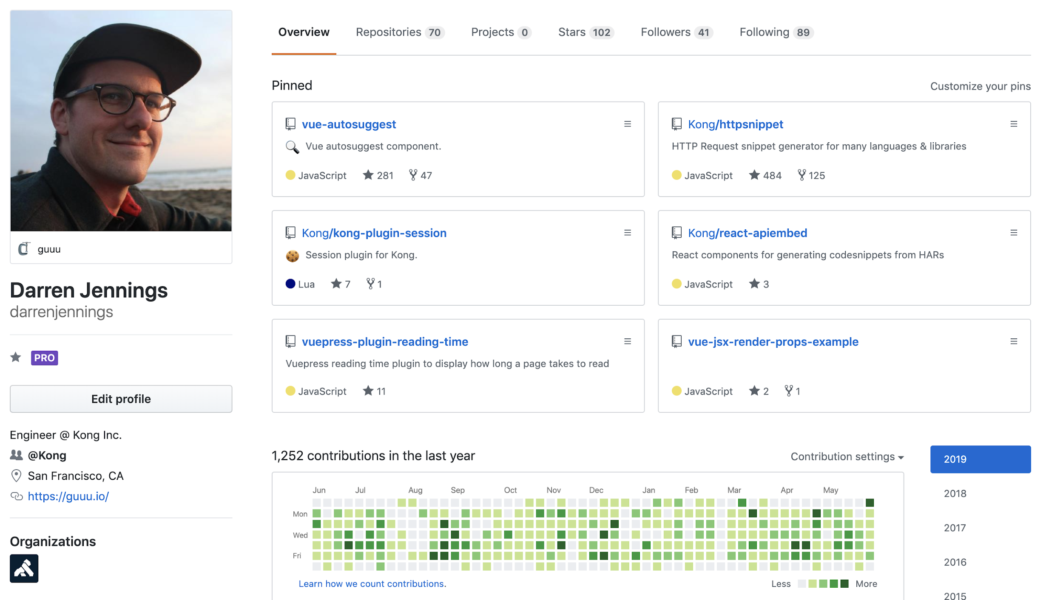
$ whoami
darrenjennings
https://guuu.io
🚨✨ https://konghq.com/careers/✨
Notes:
FIrst, quick intro, on who I am. I’m Darren and you can find me most places as @darrenjennings twitter and github, including darrenjennings.dev which will redirect to guuu.io. I work for Kong here in San Francisco where I am tech lead over a mostly frontend team building interfaces for Kong’s enterprise admin dashboard, I spend most of my time writing Vue and a server side language Lua that Kong is written in. It’s an awesome product with awesome people… and of course we’re hiring

Slide 3
What is an autosuggest component? 🤔
Vue-autosuggest 🔍🧙🏻‍♂️
Features/interactions 👇⌨️
Data Fetching 📊
Accessibility ♿️
Styling 💅
Notes:
I’m gonna cover what is an autosuggest component? How my library vue-autosuggest seeks to answer that question, and then dive into some of the implementations of what makes a good autosuggest component with data fetching, accessibility and styling

Slide 4
What is autosuggest?
SO WHAT DO I DO?
ARIA 1.1 Combobox with Listbox Popup https://www.w3.org/TR/wai-aria-practices/#combobox
§ 3.8 Combo Box
A combobox is a widget made up of the combination of two distinct elements: 1) a single-line textbox, and 2) an associated pop-up element for helping users set the value of the textbox. The popup may be a listbox, grid, tree, or dialog. Many implementations also include a third optional element -- a graphical button adjacent to the textbox, indicating the availability of the popup. Activating the button displays the popup if suggestions are available. The popup is hidden by default, and the conditions that trigger its display are specific to each implementation. Some possible popup display conditions include:
It is displayed only if a certain number of characters are typed in the textbox and those characters match some portion of one of the suggested values.
It is displayed as soon as the textbox is focused, even if the textbox is empty.
It is displayed when the Down Arrow key is pressed or the show button is activated, possibly with a dependency on the content of the textbox.
It is displayed if the value of the textbox is altered in a way that creates one or more partial matches to a suggested value.
The nature of the suggested values and the way the suggestions are presented is called the autocomplete behavior. Comboboxes can have one of four forms of autocomplete:
No autocomplete: When the popup is triggered, the suggested values it contains are the same regardless of the characters typed in the textbox. For example, the popup suggests a set of recently entered values, and the suggestions do not change as the user types.
List autocomplete with manual selection: When the popup is triggered, it presents suggested values that complete or logically correspond to the characters typed in the textbox. The character string the user has typed will become the value of the textbox unless the user selects a value in the popup.
List autocomplete with automatic selection: When the popup is triggered, it presents suggested values that complete or logically correspond to the characters typed in the textbox, and the first suggestion is automatically highlighted as selected. The automatically selected suggestion becomes the value of the textbox when the combobox loses focus unless the user chooses a different suggestion or changes the character string in the textbox.
List with inline autocomplete: This is the same as list with automatic selection with one additional feature. The portion of the selected suggestion that has not been typed by the user, a completion string, appears inline after the input cursor in the textbox. The inline completion string is visually highlighted and has a selected state.

Slide 5

1.a Building blocks: Autosuggest using HTML elements
<input type=”text”/>
autocomplete=”on,off” type=”search”, accessibility (a11y) WAI-ARIA attributes
<ul>, <ol>
unordered/ordered list. UL = bullets, OL = numbers
<li>
list items
<datalist>
Built in autocomplete? https://codepen.io/darrenjennings/pen/zQgyBw
<input list="frameworks">
<datalist id="frameworks">
<option>React</option>
<option>Vue</option>
<option>Angular</option>
<option>Svelte</option>
</datalist>
You vs. the DOM
Notes:
Take a step back… what does the browser give us?

Slide 6
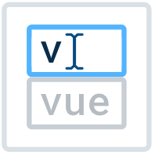
2. Vue-autosuggest
https://github.com/darrenjennings/vue-autosuggest
Handles all the hard stuff (keyboard events, accessibility, etc.)
WAI-ARIA complete autosuggest component built in Vue
Full control over rendering with built in defaults or custom components for rendering
Easily integrate data fetching
Supports multiple sections
No opinions on CSS, full control over styling
$ yarn add vue-autosuggest
$ npm install vue-autosuggest

Slide 7
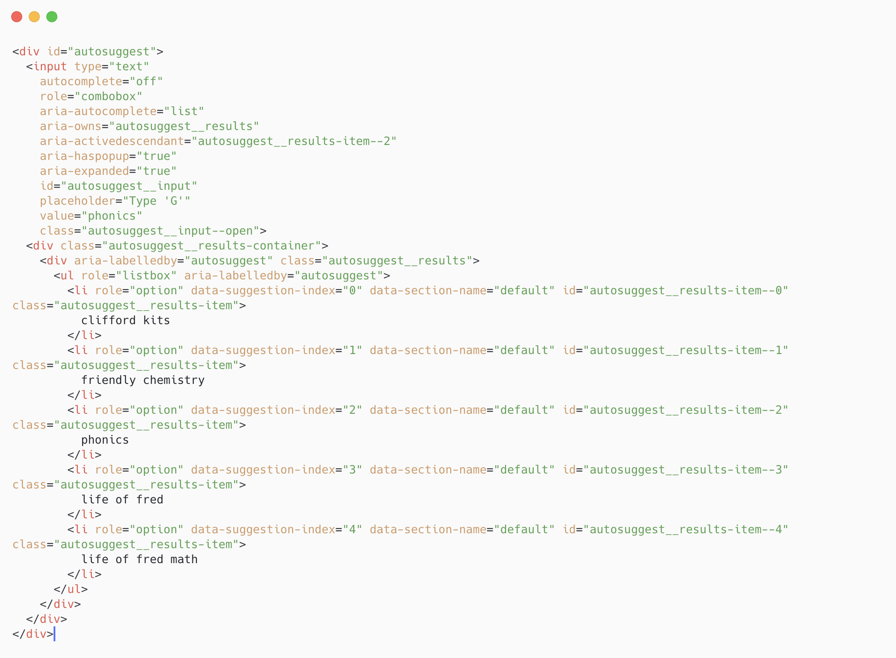
input
listbox

Slide 8
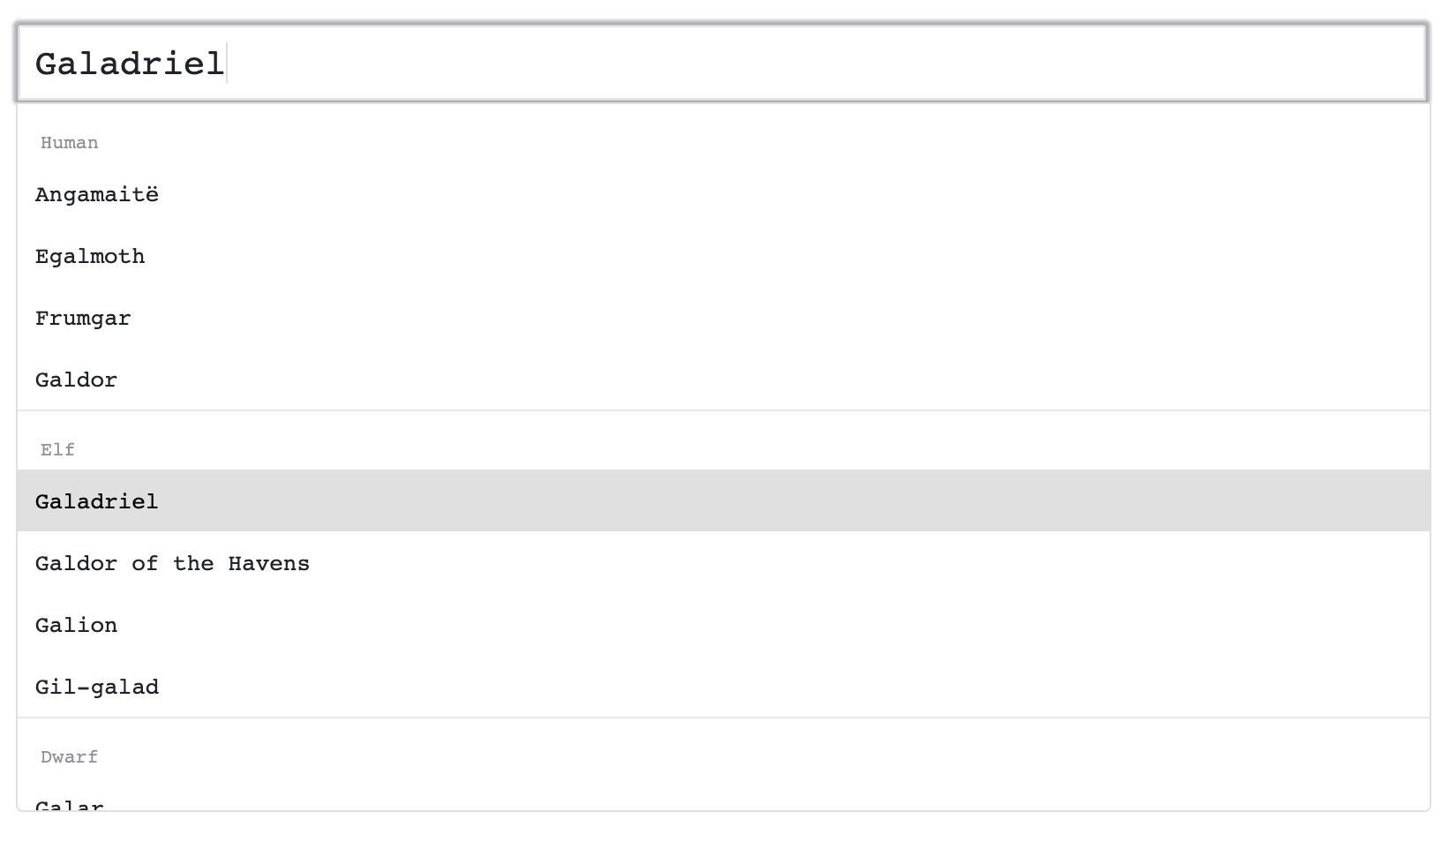
3. Features - multiple sections / slots
https://darrenjennings.github.io/vue-autosuggest/
Pseudocode html output of vue-autosuggest:
<span class=”before-results />
<li class=”before-section-users”>Human</li>
<li class=”before-section-elf”>Elf</li>
<span class=”after-results”v-if=”currentState === ‘PENDING’”>Loading...</span>
<div>
<input />
<ul>
<li>Angamite</li>
<li>Egalmoth</li>
<li>Frumgar</li>
</ul>
<ul>
<li>Galadriel</li>
<li>Galdor of the Havens</li>
<li>Galion</li>
</ul>
</div>

Slide 9
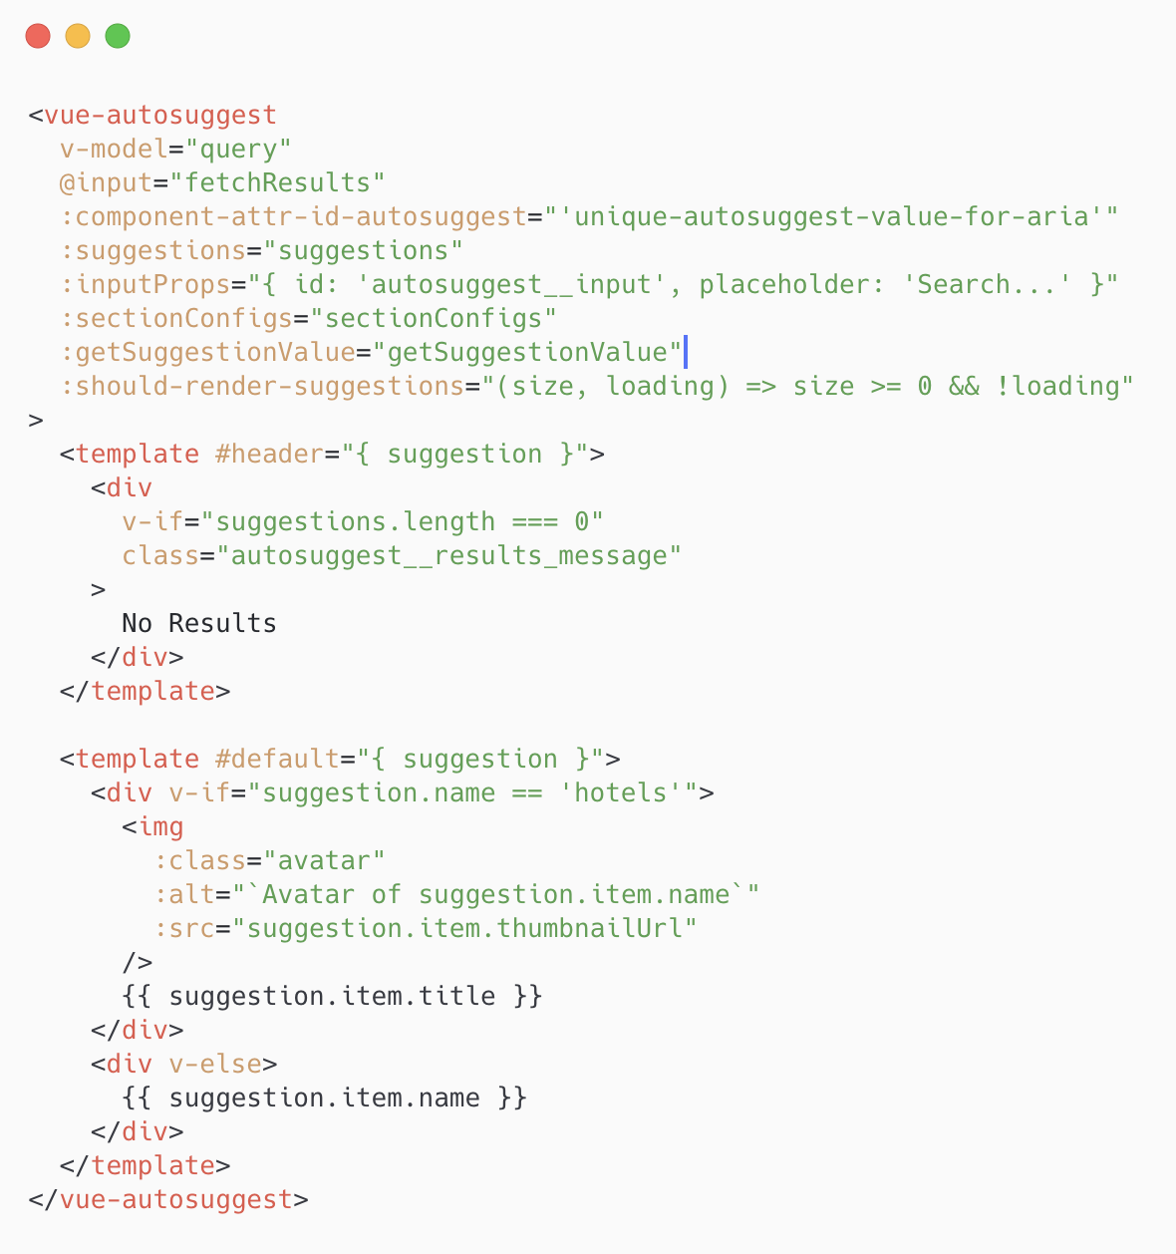
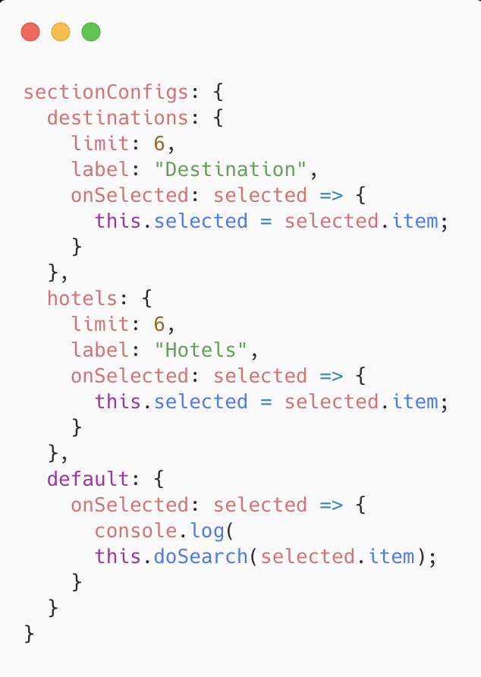
3. multiple sections cont.

Slide 10
3. Features - mouse/keyboard interactions
@click 👇🐁
input
show suggestions or wait until user starts typing? - this is optional but could be useful e.g. show some suggestions based on “most popular”
Result item
selects a result from the listbox, emits @selected event
document
Close listbox
Keydown 👇 ⌨️
Character keys
Show listbox, filter the results!
Exclude non-character keys such as shift, tab, alt/option, OS Keys
down, up (keycodes: 40, 38)
Key through results in the listbox
Input changes to preview what is being selected. Keying up to the top resets the input value back to what was originally typed
Items are always visible (scrollTo)
Keying down when reach last item resets to the first item
Update aria attributes
Enter (13)
Select a result item from the listbox
Escape (27)
Close listbox
If user closes listbox, allow them to press a key to reopen the listbox to continue checking results

Slide 11
4. Data Fetching
Developer Experience (DX) - developer user that is using vue-autosuggest to build an app
Separation of concerns (SoC)
Keep the combobox worried about what it needs to worry about.
List presentation, user interactions, ARIA state, etc.
Developers want to fetch their own data (Fetch API, axios, 3rd party api client libraries etc.)
User Experience (UX) - user of app that is using vue-autosuggest
Give user feedback of loading state, so that they’re not frustrated by why it’s not showing up
Right side spinner
“Loading…” text as result item
Debounce API calls `@input`
Wait until user has stopped typing before firing XHR requests (but not too long < 200ms)
Ask the question: is the listbox needed for functionality or can you “just search”? E.g. google

Slide 12

Third Party Data Fetching
Algolia: https://codesandbox.io/s/mystifying-cray-2vr87nyvkp
https://drive.google.com/open?id=1C_yCV_AfHyeiEWcUhw99fYFVLqqmIaH5

Slide 13
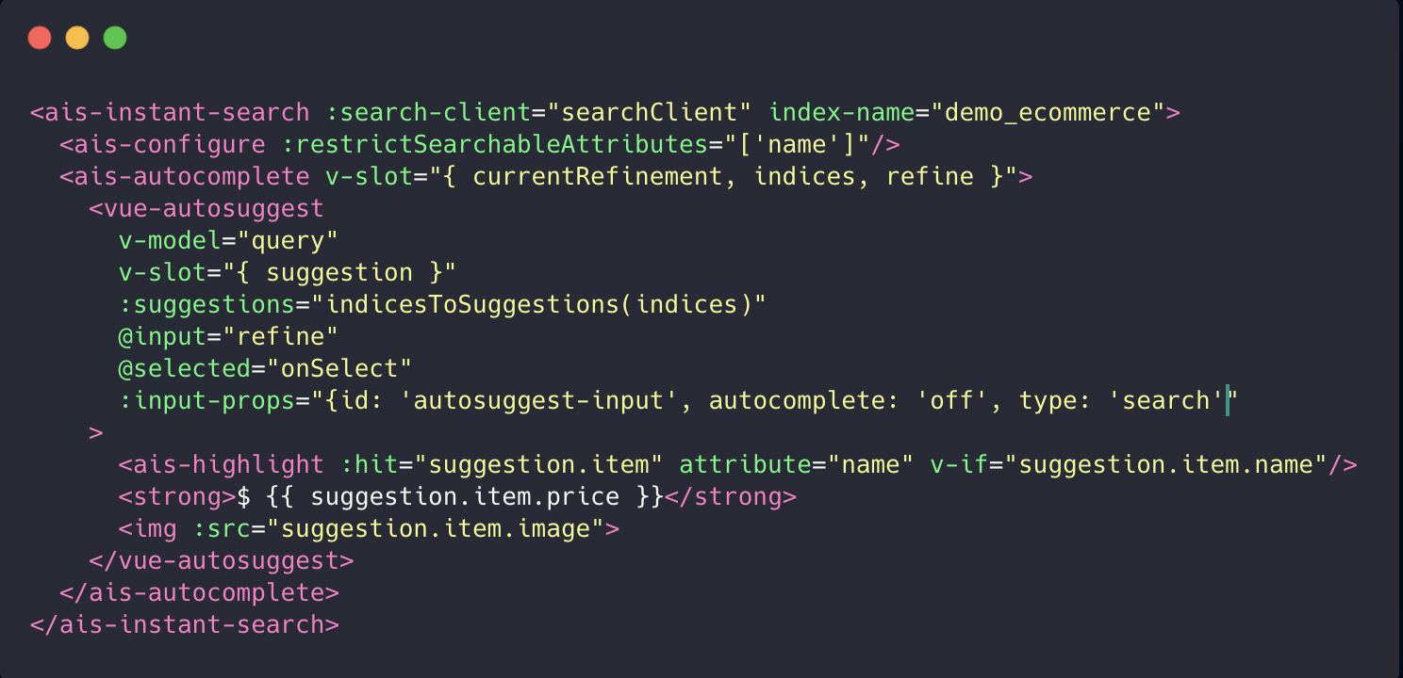

Slide 14

Data Fetching
https://drive.google.com/open?id=1GlYDOu-MEcFWYOHSVAtpSWD7iRFdi9LO

Slide 15
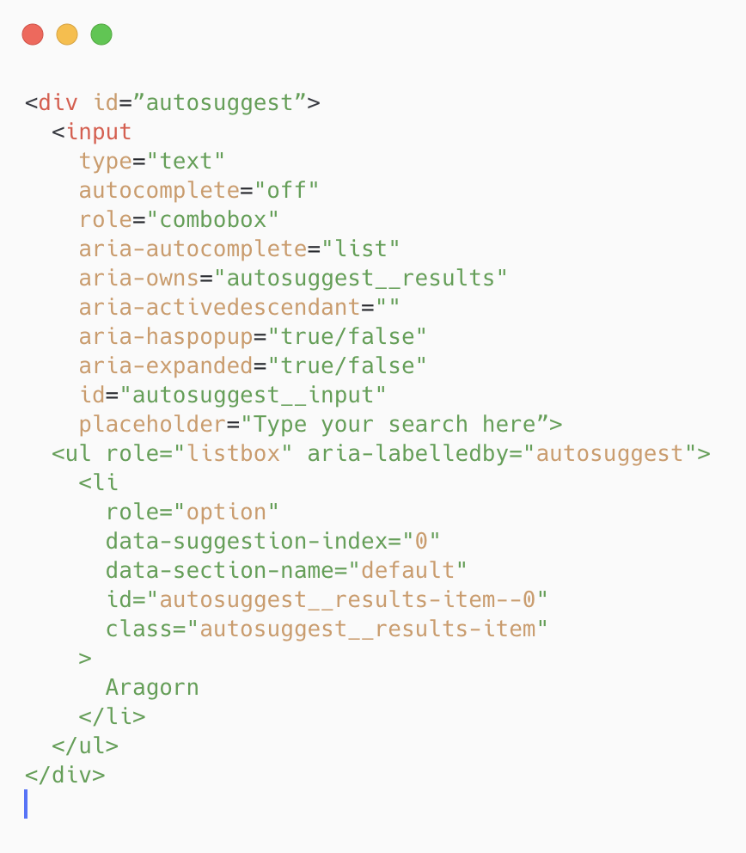
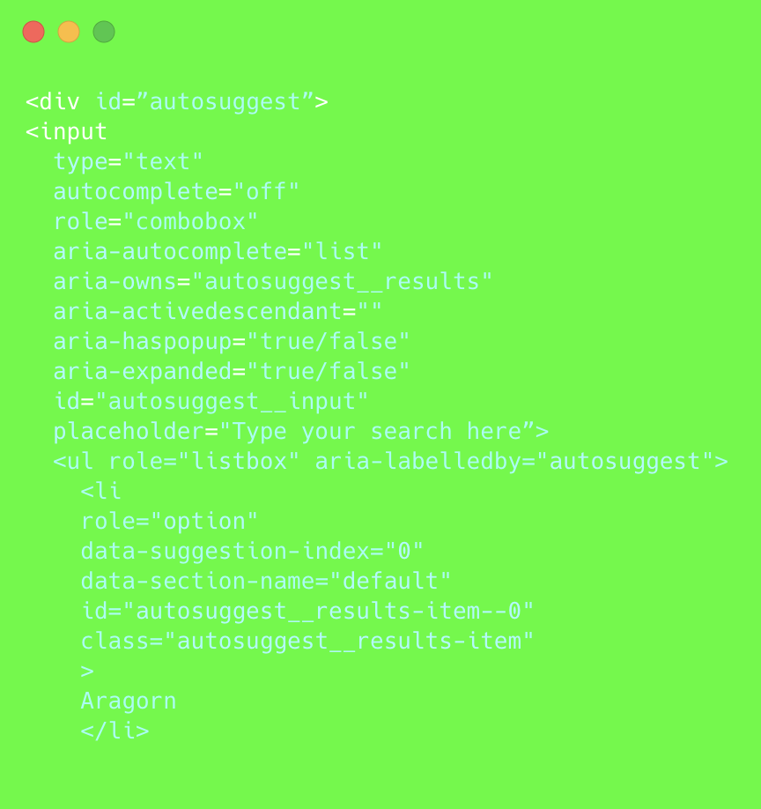
5. Accessibility (A11y)
Should be screen reader friendly
Aria attributes reflect state of listbox
WAI-ARIA complete (Web Accessibility Initiative – Accessible Rich Internet Applications)
https://www.w3.org/TR/wai-aria-1.1/
Big document on how to author components to be accessible to specifications
keyboard interactions
Intuitive
follow specs
customizable

Slide 16

6. Styling
https://drive.google.com/open?id=16eb6q2xG5sM9OqWeiYiYJCFPSwKPxqF9
DEMO
Allow scroll
`overflow-y`
Always plan for the states, e.g. the fetch machine
Idle
Pending
Reject
Resolve
Results / no results
Result items should be able to allow any html and auto adjust height accordingly
The chrome “omnibox”
Listbox results to be an extension of the input
Inlines important results
Ghost riding the input
No loading state?! Ask the question: Is the autosuggest needed for functionality?

Slide 17

Thank you

